Slide 1
Political Polarization
Leonardo Matone
of the US House of Representatives

Slide 2
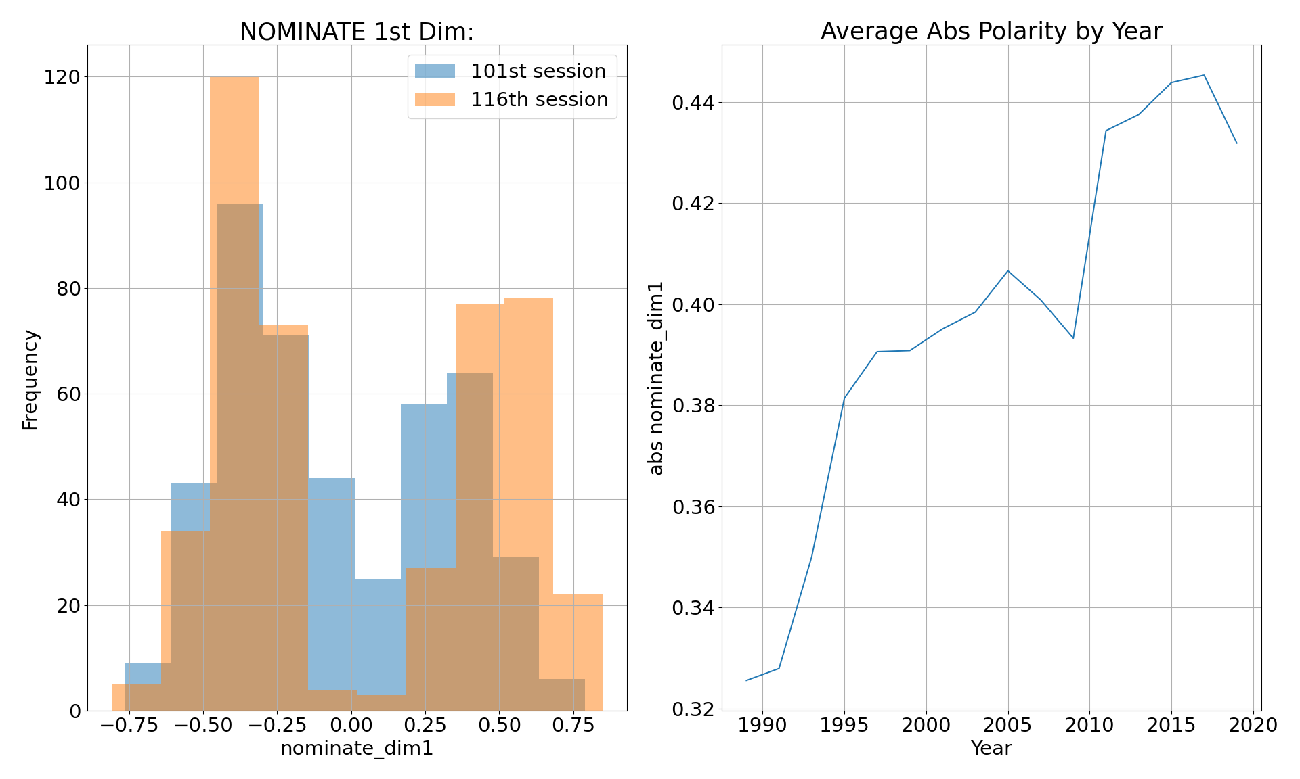
Who cares?
You should!
Pernicious polarization has been linked to democratic erosion*
We are the fastest polarizing country in the world*
Constituent responsibility
Representative “truths” are heavily obfuscated in the digital age
Understand who you are voting for!
What makes a representative?
*Carnegie, “What Happens When Democracies Become Perniciously Polarized?
*Brown, “U.S. is Polarizing Faster Than Other Democracies”

Slide 3






Data Collection:
Rep Finances
State Demographics
Poverty Aggregates/ Distribution of Race
Data on Poverty Tax Exemptions
Personal Finance
Religious Populations
Campaign Finance
Decennial Population / Geodata

Slide 4
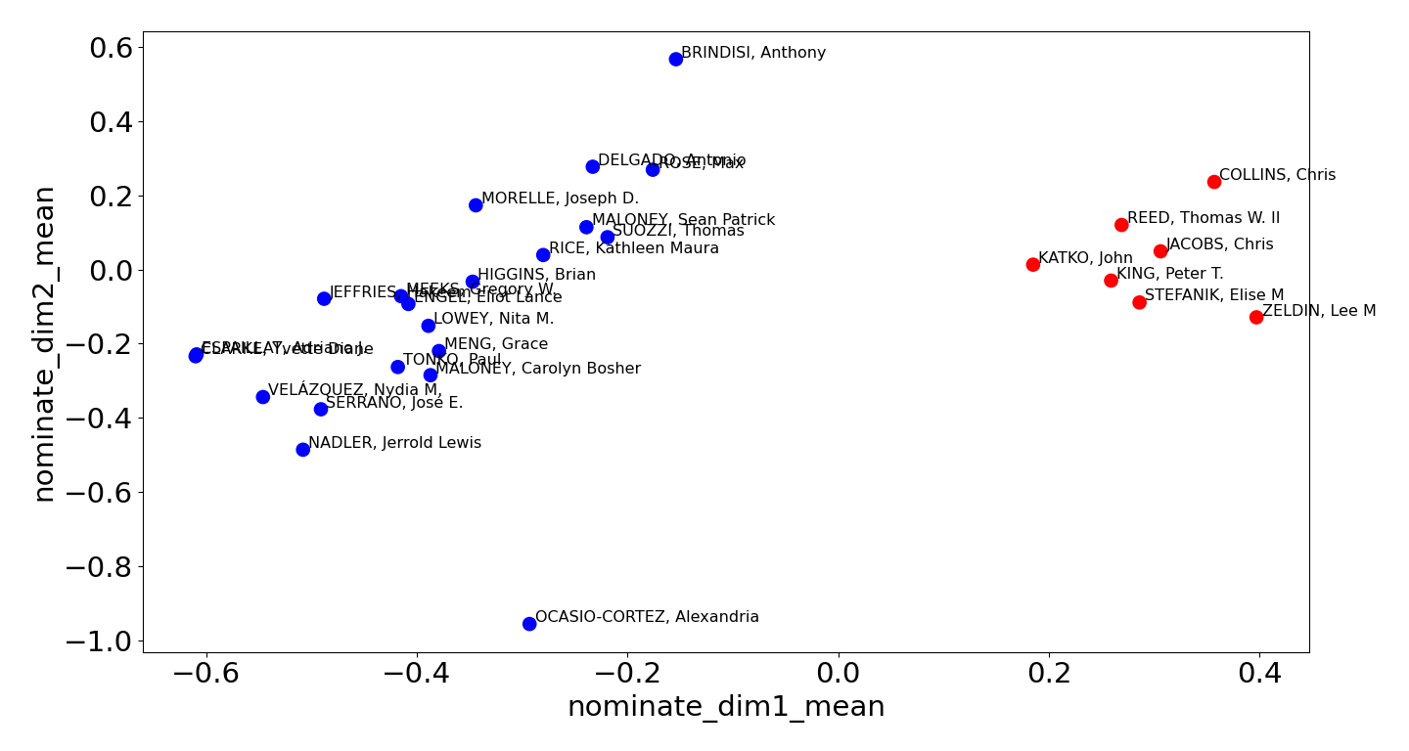
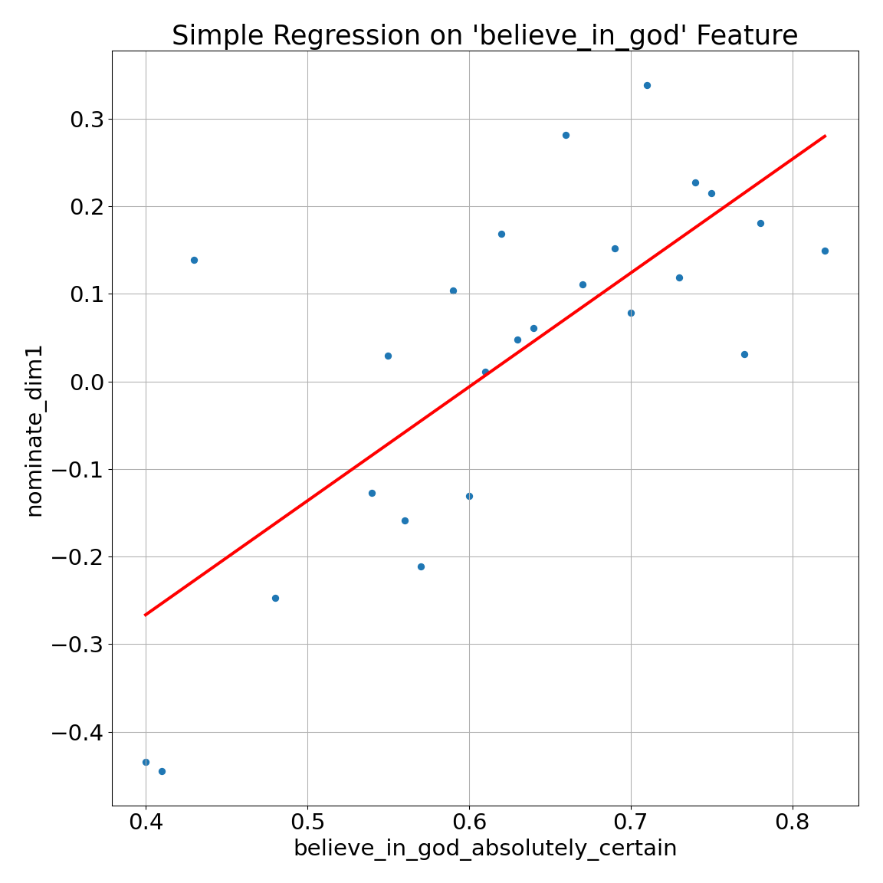
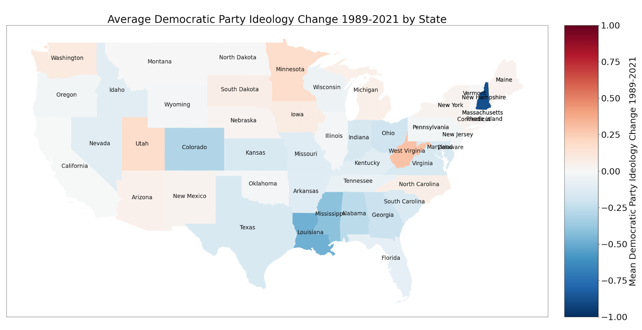
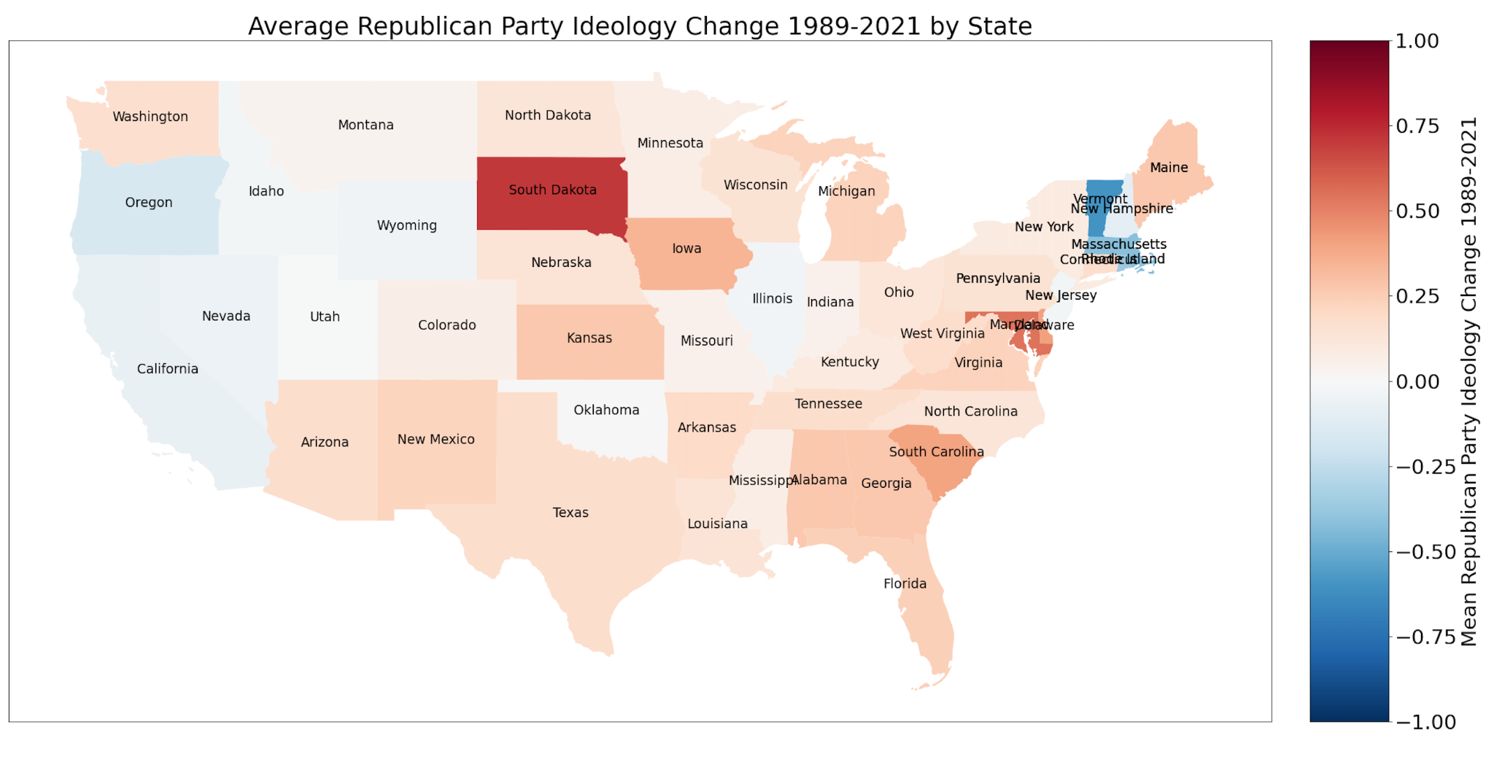
EDA Highlights:
Figure 1:
New York’s 116th Congress House Members:
Findings:
Location/party are very important
State polarization is high, but has direction
Key population features like religion might be able to fill in the blanks
Figure 2:
Figure 3:

Slide 5
Hypothesis:
Can we predict the nominate scores (polarity) of a representative without knowing their voting history?
Pros:
States/Districts have high relation to nominate scores
Features of the population are correlated with the representatives they choose
Cons:
Our population data is only on a state level, we miss specificity for district-level predictions
(not pictured) Heatmaps demonstrate very small correlations with representative financial information

Slide 6
Model (preliminary):
Methodology:
Best model (so far):
Surface level training (default score):
LinearRegression: 0.8
KNNRegression: 0.2
SKL-MLP: -0.02
TF-DNN (using MAE): 0.4
AdaBoost: 0.8
GradientBoosting: 0.87
Hyperparameter fine-tuning with GridSearchCV
Final result: →
GradientBoostingRegressor(learning_rate=0.02, max_depth=10, n_estimators=1500,
subsample=0.5)
Score (test set, after training) : 0.926804992388809

Slide 7

Conclusions:
Coeff_d = 1 - ( ((y_true - y_pred)** 2).sum() / ((y_true - y_true.mean()) ** 2).sum() )
Best Coefficient of Determination:
Best Performing:
Best MSE:
GradientBoost
0.921301115720505
0.012447437977565
We can roughly estimate polarity using data on a representative and their constituents
Constituents can help to indicate where the polarity of a representative will lean
Example prediction:
(data from test set, no peeking)
representative: KING, Peter T.
party: republican,
congress: 106th
nominate_dim1:
predicted: 0.25392123595221316
true y : 0.259

